Slide 1
STRATEGIC MARKETING
Managing Marketing Communications
Prof. Mohammed Rafiq
Professor of Marketing

Slide 2
Learning Objectives
Understand the communication process and the traditional promotion mix.
Discuss the need for integrated marketing communications.
Describe the steps in traditional and multichannel promotion planning.
Explain the role of Hierarchy of Effects
Explain the roles played by the different elements of the promotion mix in the communication strategy

Slide 3
Communication Models in a Digital World That is “Always On”
Marketing messages can assume many forms with a variety of objectives.
From quirky TV commercials and viral videos to blimps with blinking messages
Savvy marketers know each element of the marketing mix is a form of communication!
All marketing communications aim to either inform, remind, persuade, or build relationships.

Slide 4
Integrated Marketing Communications (IMC)
Integrated marketing communication (IMC) involves the planning, execution, and evaluation of coordinated, brand communication programs over time to targeted audiences.
Aim is to deliver consistent messaging across platforms.
Must use a multichannel promotion strategy which combines traditional marketing communication with social media and other online activities.

Slide 5
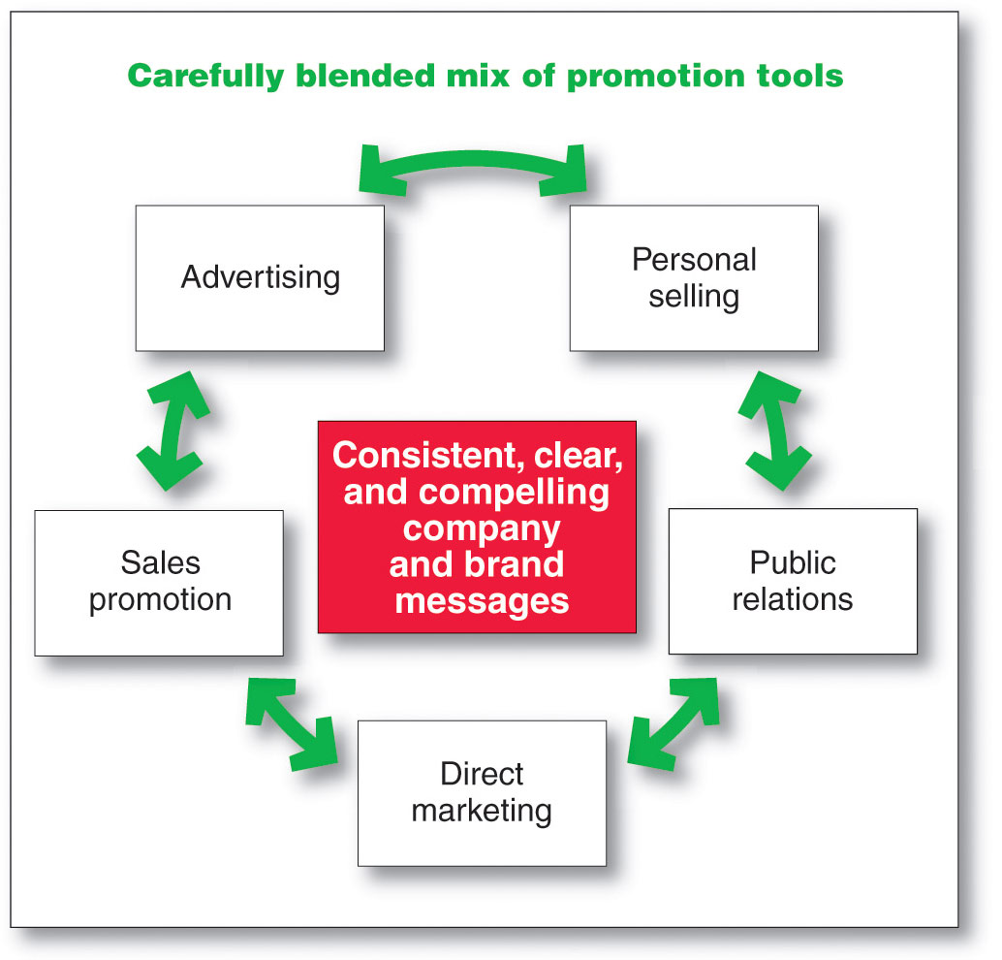
Integrated Marketing Communications Strategy
Copyright ©2014 by Pearson Education

Slide 6
The Traditional Promotional Mix
Promotion mix refers to communication elements that the marketer controls.
Mass (one-to-many) communication: includes advertising, sales promotion, and public relations.
Personal (one-to-one) communication:
includes personal selling and direct marketing.
includes Individualized/ personalized communication/ adverts on the web

Slide 7
Mass Communications: The One-to-Many Model
Some elements of the promotion mix include messages intended to reach many prospective customers at the same time.
Advertising
Consumer sales promotion
Public relations

Slide 8
Personal Communications: The One-to-One Model
Marketers may sometimes prefer to communicate on a personal level.
Personal selling
Direct mail
Telemarketing
Direct marketing

Slide 9
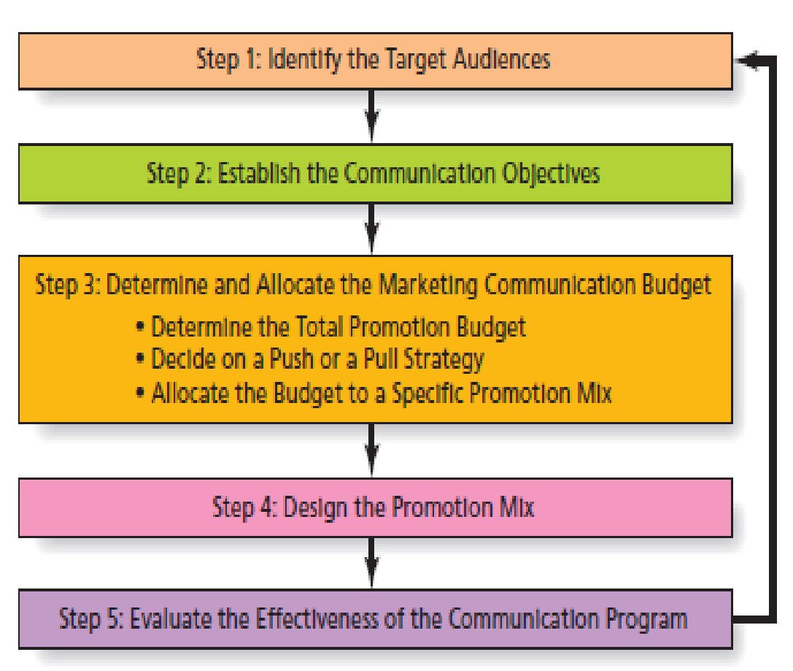
Steps to Develop the Promotional Plan

Slide 10
Step 1: Identify the Target Audience(s)
Must communicate with more than just members of the target market
Other stakeholders influence the target market
Consumers learn about products from
News media
Friends and family
Producers of competitive products
Social Media

Slide 11
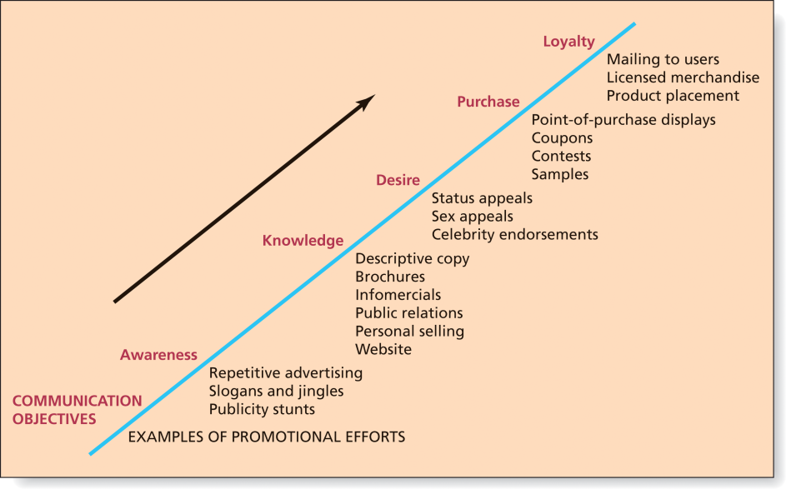
Step 2: Establish the Communication Objectives
Creating a new customer occurs as a result of a series of messages.
Messages are designed to move the consumer closer to purchase, and hopefully, loyalty through a series of steps known as the hierarchy of effects.

Slide 12
Hierarchy of Effects

Slide 13
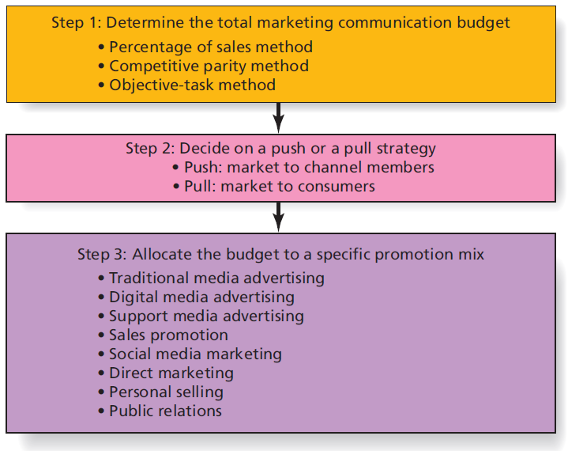
Step 3: Determine the Marketing Communication Budget

Slide 14
Determine the Total Marketing Communication Budget
Top-down budgeting techniques
Percentage-of-Sales method
Competitive-parity method
Bottom-up budgeting techniques
Objective-task method

Slide 15
Shaping the Overall Promotion Mix
Promotion Mix Strategies
Copyright © 2016 Pearson Education, Inc.
14-38

Slide 16
Step 4: Design the Promotion Mix
Designing the promotion mix involves:
Determining communication tools to be used
Specifying message to be communicated
Determining the communication channels to be used.

Slide 17
Step 5: Evaluate the Effectiveness of the Communication Program
Marketers use a variety of ways to monitor and evaluate the company’s communication efforts.
Various types of sales promotion are the easiest to evaluate as they often occur over a fixed, short period.
Advertising has lagged or delayed effects, more difficult to clearly link to sales.
Measure brand awareness, recall of product benefits communicated, and image of the brand before and after an ad campaign.

Slide 18
Multichannel Promotion Strategies
Combination of traditional advertising, sales promotion, public relations, and direct marketing activities with social media activities
Boost effectiveness of either online or offline strategies used alone
Allow marketers to repeat their messages across various channels.

Slide 19
Promotion Planning
Developing a promotion plan that delivers the right message to the right target market is not easy!
Marketers follow sequence of promotion planning steps.
Hierarchy of effects charts consumers’ path to brand loyalty and guides objective setting.

Slide 20
Advertising (1 of 2)
Advertising is non-personal communication from an identified sponsor using mass media.
Practice dates to ancient Greece and Rome.
Changes in media landscape have slowed growth of traditional advertising …
But mass communications remains the best way to reach a large audience

Slide 21
Advertising (2 of 2)
TV Everywhere (also known as Authenticated Streaming) is the use of an internet-enabled device, like a tablet or smartphone, to stream content from a cable or satellite provider.

Slide 22
Social Media Marketing
Marketers no longer are the only ones who talk about their products.
Millions of consumers have the ability and desire to spread good (or bad) news about products.
The many-to-many communication model is based on consumers talking to one another about goods, services, and organizations.
The changing communication landscape has been referred to as the groundswell.

Slide 23
Social Media
Internet-based platforms that allow users to create their own content and share it with others who access these sites.
Examples of social media include Facebook, Twitter, Pinterest, YouTube, Yelp, Wikipedia, Second Life and Tik-Tok.

Slide 24
Social Networks
Social networks, like Facebook and Twitter, are sites that connect people with other people.
Marketers monitor social networks to learn what consumers are thinking about the brand and the competition..
Marketers reach influential opinion leaders by participating in social media conversations.
Use of “Influencers”
Social networks provide an opportunity to create a brand community.

Slide 25
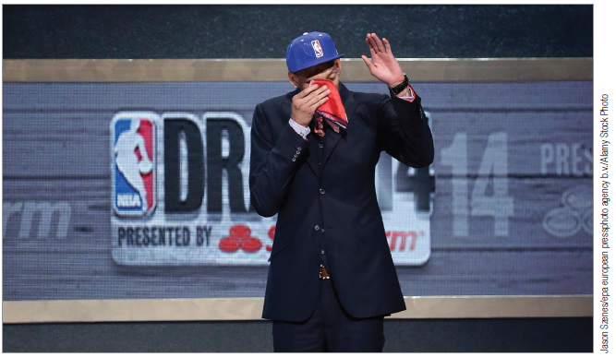
Public Relations
Marketers create and manage publicity, which is unpaid media exposure about a company
Crisis management: (the most important PR function) the process of managing a firm’s reputation when a negative event threatens the organization’s image

Slide 26
Buzz Marketing
Buzz: word-of-mouth communication that customers view as authentic.
Buzz marketing: marketing activities designed to create conversation, excitement and enthusiasm about a brand.
Makes PR a more important part of the promotion mix.

Slide 27
Direct Marketing
Any direct communication to a consumer or business designed to generate a response in the form of an order, a request for further information or a visit to a place of business for purchase of a product.
Includes mail order, telemarketing, direct response advertising and M-commerce

Slide 28
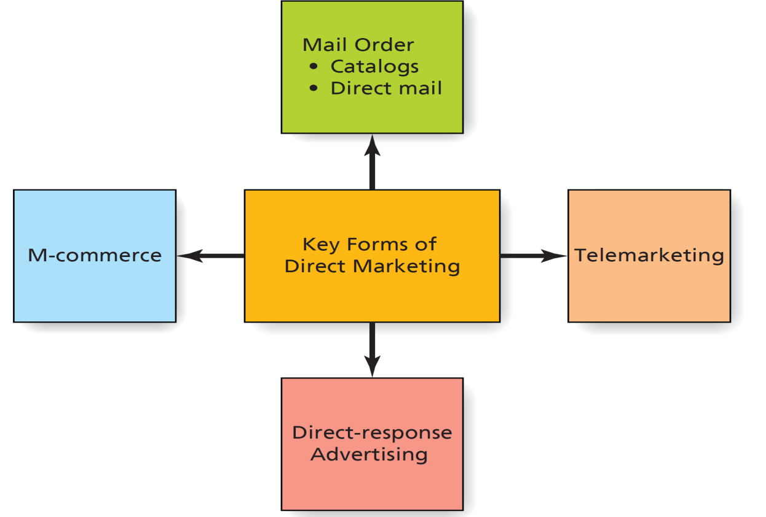
Key Forms of Direct Marketing
Direct marketing: direct communication to a customer designed to generate a response

Slide 29
Mail Order
Mail order comes in two forms:
Catalog: a collection of products offered in book form, usually consisting of product descriptions and accompanied by photos of the item
Direct mail: a brochure/pamphlet offering a specific good or service at one point in time
Catalog Choice

Slide 30
Telemarketing
Telemarketing: The use of the telephone to sell directly to consumers and business customers.
Profitable way for B2B marketers to keep in touch with small clients.
FTC established the National Do Not Call Registry to allow consumers to limit number of telemarketing calls they receive.
Do Not Call Registry

Slide 31
Direct Response Advertising
Direct-response advertising allows consumer to respond by immediately contacting the provider with questions or an order.
Direct-response TV (DRTV) includes short commercials of less than 2 minutes, 30-minute or longer infomercials and home shopping networks.
Infomercials are typically half-hour or hour-long commercials that resemble a talk show, often with heavy product demonstration elements.

Slide 32
Personal Selling: Adding the Personal Touch to the Promotion Mix
Personal selling occurs when a company rep interacts directly with a customer or prospective customer to communicate about a good or service.
Far more intimate form of promotion compared to mass-media material
Salespeople are the eyes and ears of firm.

